Slide 1
Unit 3
Machine Learning : Probability, Statistics, Linear algebra (applied focus)
Supervised, unsupervised, and reinforcement learning: concepts and real-world use
Feature engineering and model evaluation (cross-validation, precision, recall)
Bayes theorem, Bayesian networks and probabilistic reasoning

Slide 2
Machine Learning : Probability, Statistics, Linear algebra (applied focus)
Probability means:
How likely something is to happen.
It always lies between: 0≤P≤1
0 → Impossible
1 → Certain
0.5 → 50% chance

Slide 3
Machine learning deals with uncertain data.
Example:
Is this email spam?
Does this patient have diabetes?
Will this customer buy a product?
The model does not say only Yes or No.
It says:
“There is 80% chance this is spam.”
That 80% comes from probability.

Slide 4
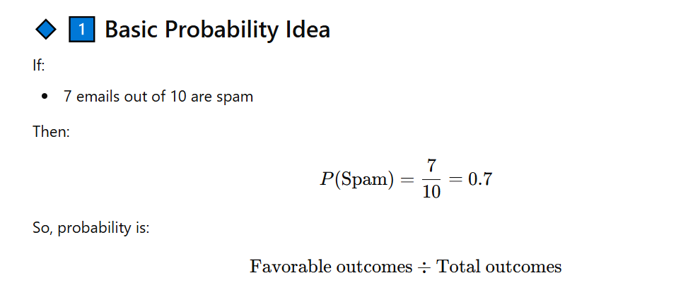

Slide 5
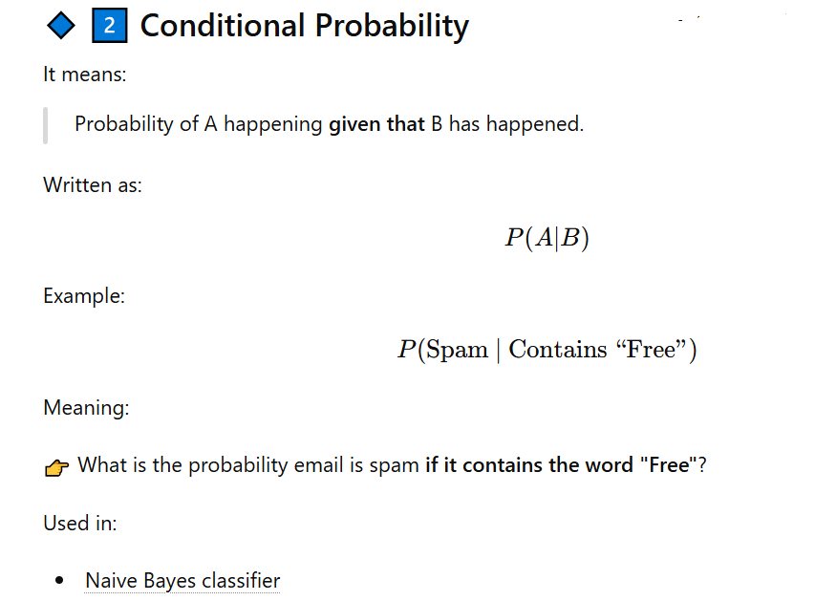

Slide 6
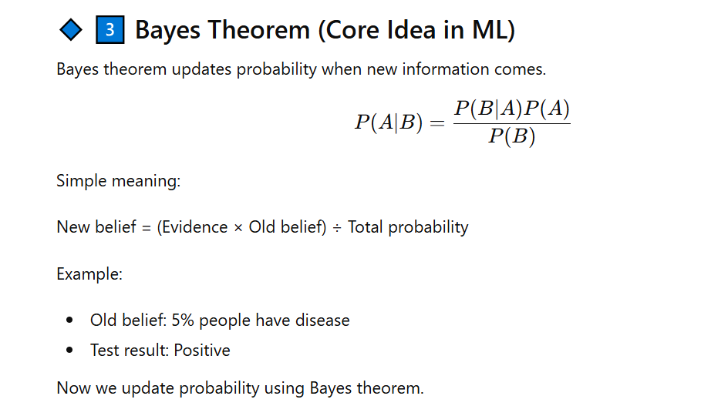

Slide 7
Probability in ML helps us answer:
“How confident is the model about its prediction?”

Slide 8
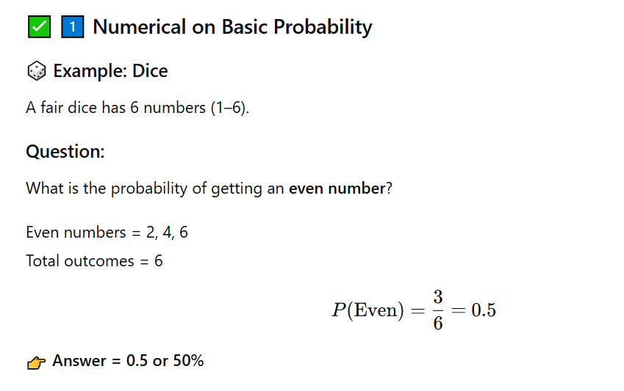

Slide 9
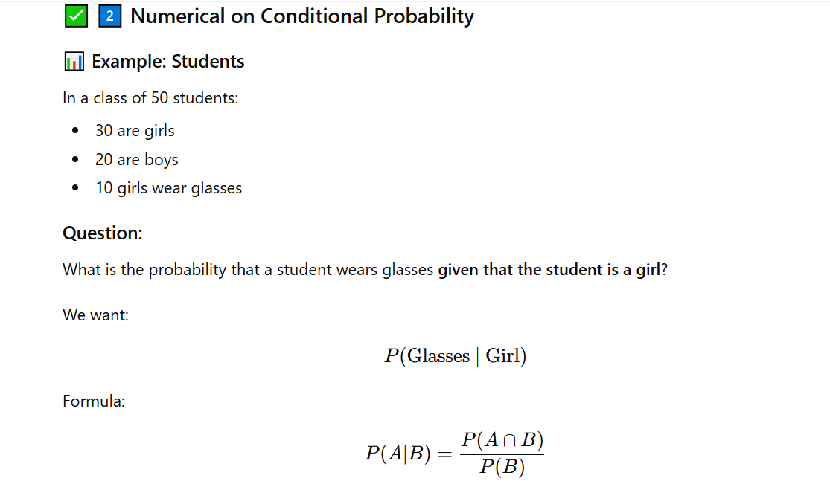

Slide 10
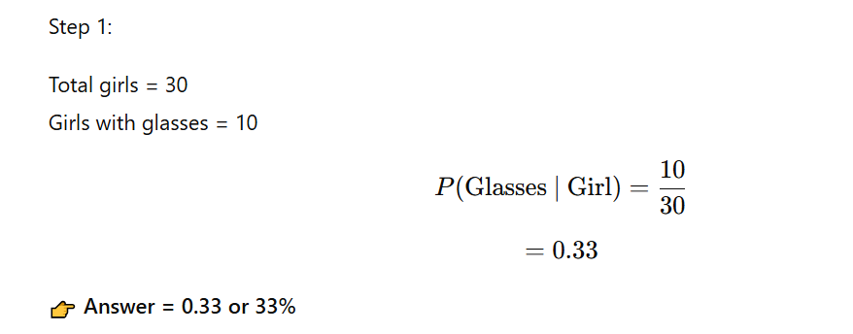

Slide 11
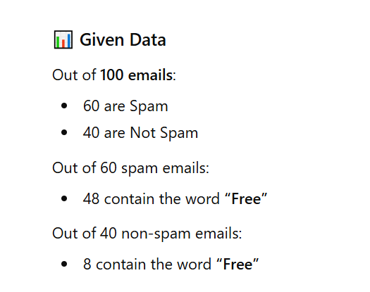
Bayes Theorem

Slide 12
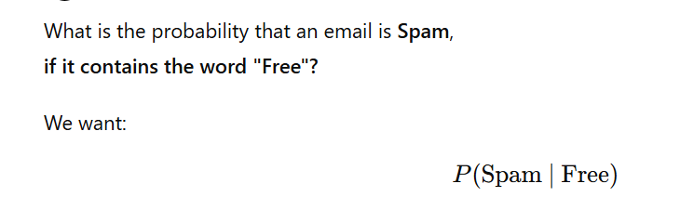

Slide 13
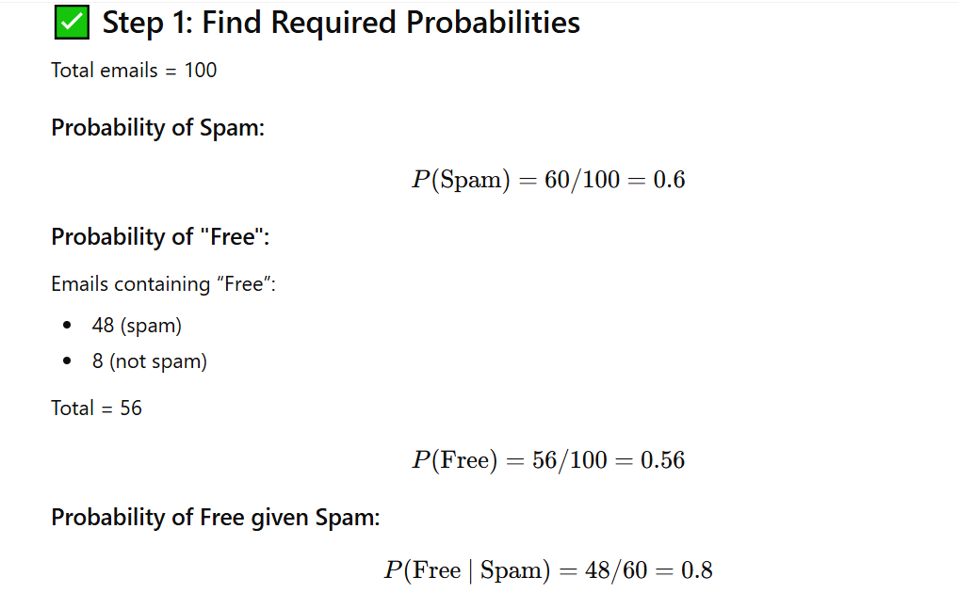

Slide 14
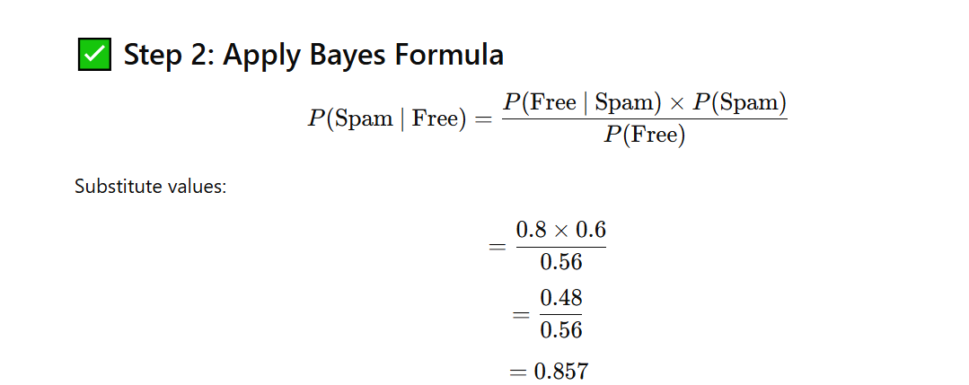

Slide 15
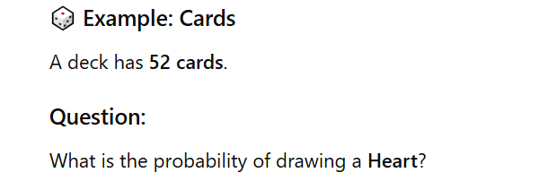
Practice

Slide 16
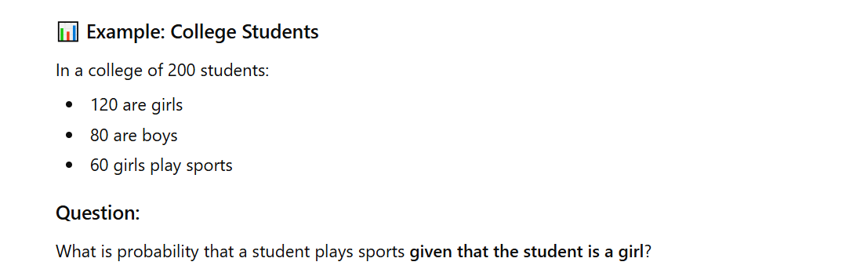

Slide 17
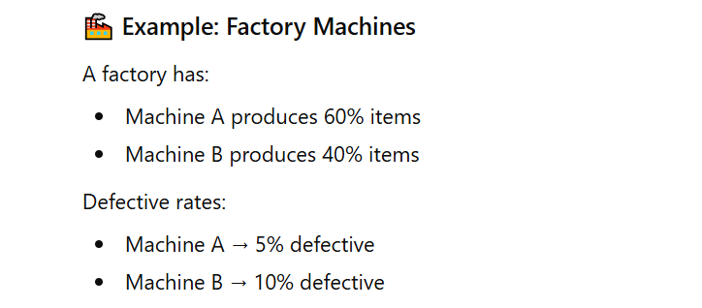

Slide 18
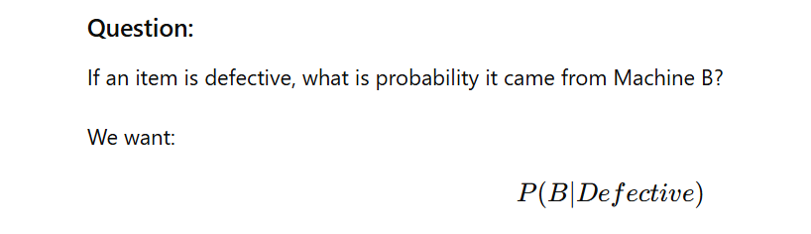

Slide 19
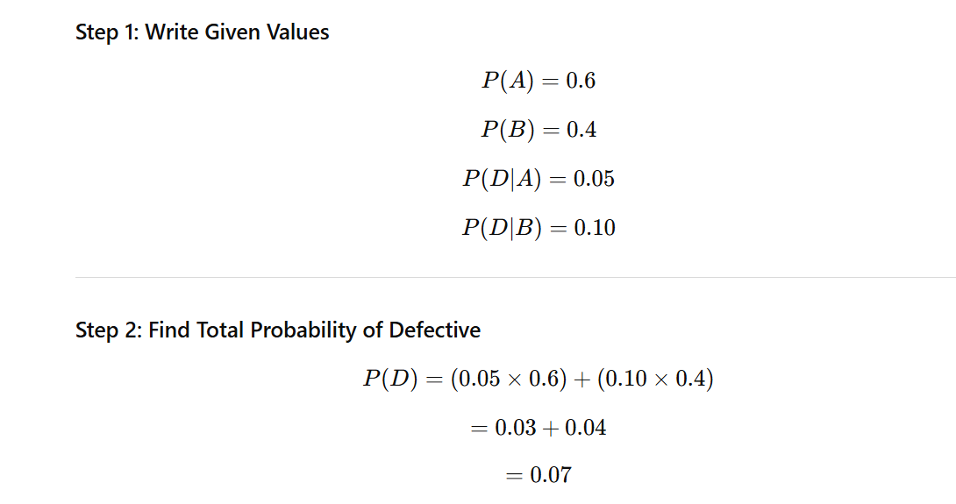

Slide 20
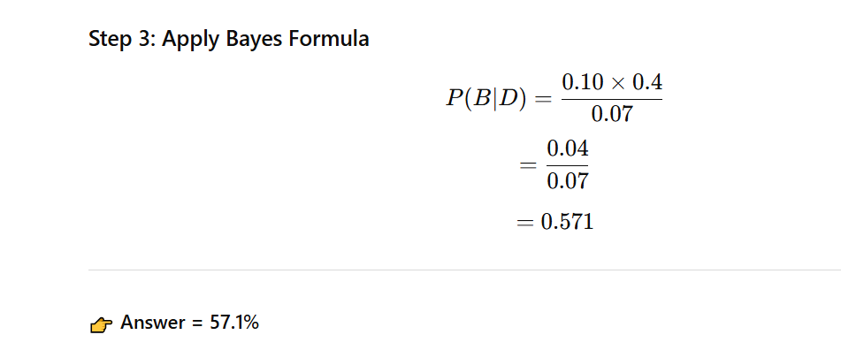

Slide 21
Types of Learning
Supervised Learning
Meaning: The machine learns from labeled data (we already know the correct answers).
Goal: Learn the mapping from input → output.
Example:
You show the model pictures of fruits with labels:“Apple”, “Banana”, “Orange”.
The model learns to classify new pictures correctly.
Used for: Classification (spam vs not spam), Regression (house price prediction).

Slide 22
Unsupervised Learning
Meaning: The machine learns from unlabeled data (no correct answers given).
Goal: Find hidden patterns, groups, or structure in data.
Example:
You give the model pictures of fruits but with no labels.
The model groups them into clusters: all apples together, bananas together, oranges together — without being told their names.
Used for: Clustering (customer segmentation), Dimensionality reduction (data compression).

Slide 23
Supervised learning → Learn with answers provided.
Unsupervised learning → Learn without answers, find patterns yourself.

Slide 24
Reinforcement Learning (RL)
Reinforcement Learning is a type of machine learning where an agent learns to make decisions by interacting with an environment, aiming to maximize reward.
Think of it like training a pet dog:
When the dog does the right trick → you give a biscuit (reward)
When it does something wrong → no treat (or mild punishment) Over time, the dog learns which actions bring rewards.

Slide 25
Key Parts of RL:
Agent → The learner/decision maker (robot, AI program, game character).
Environment → The world the agent interacts with (a game, a maze, stock market, real world).
Action → What the agent does (move left, right, jump, invest, etc.).
State → The current situation (where the agent is, what it sees).
Reward → Feedback signal (positive or negative) telling how good the action was.

Slide 26
Real-Life Examples:
Self-driving Cars
Action: Brake, accelerate, turn.
Reward: Staying safe & reaching destination without accidents.
Games (Chess, Go, Atari, etc.)
Action: Move a piece.
Reward: Winning points or the game.
Robotics
Robot arm learns to pick up an object.
Reward: Successfully grabbing and placing it.
Personalized Recommendations (Netflix/YouTube)
Action: Suggest a movie/video.
Reward: User clicks and watches → positive reward.

Slide 27
Classification Vs Clustering Vs Regresion
1. Classification (labels / categories)
Goal: Put data into fixed groups (classes).
Output: Discrete labels (Yes/No, Cat/Dog, Spam/Not Spam).
Example:
Email filter → “Spam” or “Not Spam”.
Medical test → “Positive” or “Negative”

Slide 28
2. Regression (numbers / prediction)
Goal: Predict a continuous value (a number).
Output: Real values (0.5, 73.2, etc.).
Example:
Predict house price = ₹45,20,000.
Predict tomorrow’s temperature = 32.5°C.

Slide 29
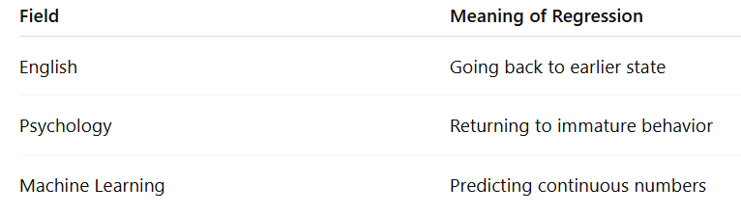

Slide 30
Example 1: House Price
Suppose we have data of houses:
Size = 1000 sq. ft → Price = ₹30 lakhs
Size = 1500 sq. ft → Price = ₹45 lakhs
Size = 2000 sq. ft → Price = ₹60 lakhs
If someone asks: “What would be the price of a 1700 sq. ft house?”
Regression predicts this number (maybe ~₹51 lakhs).

Slide 31
Example 2: Student Marks
Study hours vs. Exam Marks.
If you study 2 hrs → 50 marks, 4 hrs → 65 marks, 6 hrs → 80 marks.
Regression finds the trend/line and predicts marks for 5 hrs (~72).

Slide 32
3. Clustering (grouping without labels)
Goal: Group similar data points together (no predefined labels).
Output: Clusters of similar things.
Example:
Grouping customers by shopping habits (loyalty, luxury, budget).
Grouping students by learning style (fast, average, slow).
finding natural groups without knowing them before.

Slide 33
Classification → Predict categories (cat/dog).
Regression → Predict numbers (price, temperature).
Clustering → Discover groups (similar customers).

Slide 34
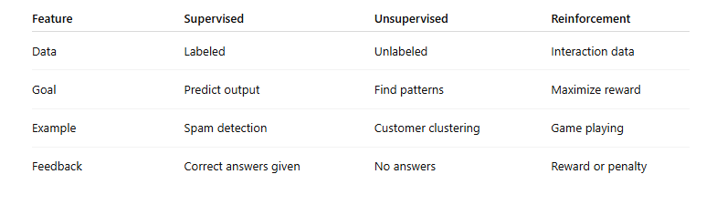

Slide 35
Feature Engineering & Model Evaluation
Understanding Cross-Validation, Precision & Recall

Slide 36
Why Feature Engineering?
Raw data is not directly usable
Machines understand numbers, not meaning
Better features → Better model performance

Slide 37
What is a Feature?
Feature = Input variable used by ML model
Example: Attendance %, Study hours
Previous marks, Assignment score

Slide 38
What is Feature Engineering?
Process of transforming raw data into meaningful features
Raw Data → Clean → Transform → Improve → Model

Slide 39
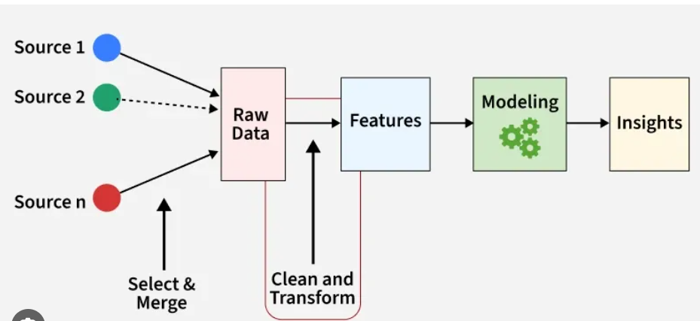

Slide 40
Feature Transformation Example
Date of Birth = 2002
Engineered Feature: Age = 2026 – 2002 = 24

Slide 41
Encoding Categorical Data
Gender: Male / Female
Encoded as: Male = 0, Female = 1

Slide 42
Feature Scaling
Salary = 5,00,000
Experience = 2 years
Scaling formula: X' = (X - Xmin) / (Xmax - Xmin)

Slide 43
Creating New Features
Length = 10, Width = 5
New Feature: Area = Length × Width

Slide 44
Why Feature Engineering Matters?
Improves accuracy
Reduces overfitting
Removes irrelevant features

Slide 45
Why Model Evaluation?
Test model on unseen data
Training Data ≠ Testing Data

Slide 46
Train-Test Split
Typical split: 70% Training, 30% Testing
Training → Learn
Testing → Evaluate

Slide 47
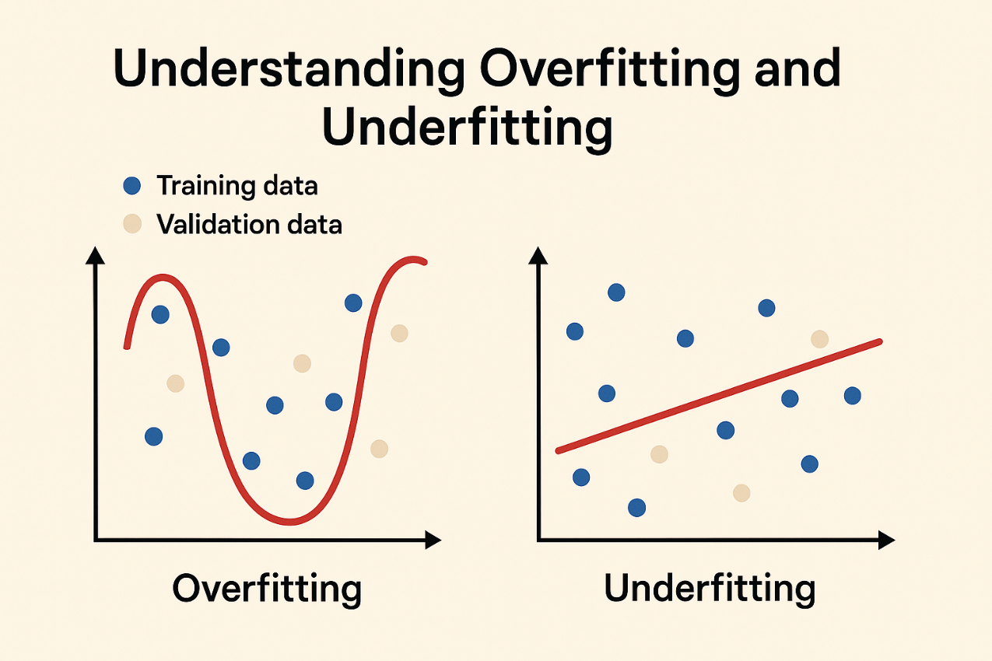
Overfitting vs Underfitting
Overfitting: High train accuracy, Low test accuracy
Underfitting: Low train & test accuracy

Slide 48
Problem with Single Train-Test Split
Random split may give biased results

Slide 49
What is Cross-Validation?
Divide data into K folds
Train on K-1 folds
Test on 1 fold
Repeat K times
Take average performance

Slide 50
5-Fold Cross-Validation Example
Data = 100 samples, Each fold = 20
Accuracies: 72%, 75%, 74%, 73%, 76%
Final Accuracy = 74%

Slide 51
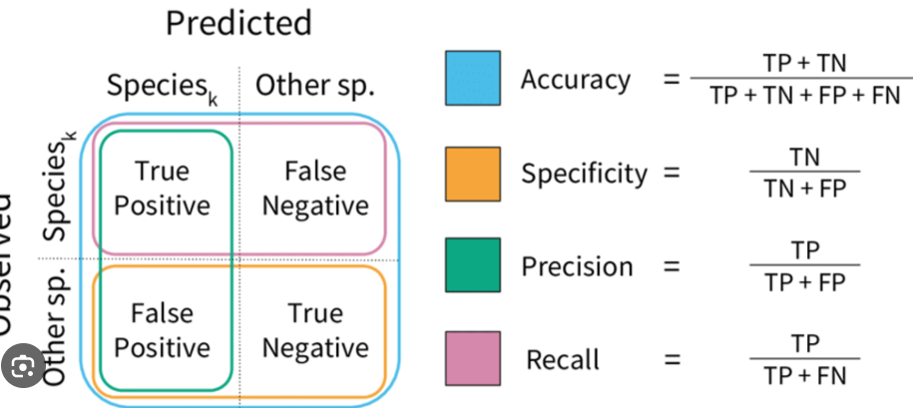
Confusion Matrix
Actual vs Predicted
True Positive (TP)
False Positive (FP)
False Negative (FN)
True Negative (TN)

Slide 52
Airport Security AI System
An international airport installs an AI-based security screening system that scans passenger luggage and predicts whether a bag contains a dangerous item.
The AI system gives two possible predictions:
Dangerous Item Detected or No Dangerous Item
After the security inspection, the actual truth about the bag is discovered by manual checking.
During one day, the following results were observed.
A passenger bag actually contained a knife, and the AI system correctly detected it as dangerous.
A passenger bag did not contain any dangerous item, but the AI system flagged it as dangerous.
A passenger bag actually contained explosives, but the AI system failed to detect it.
A passenger bag did not contain anything dangerous, and the AI system correctly allowed it through.

Slide 53
classify each situation into the following categories:
True Positive False Positive True Negative False Negative
construct the confusion matrix.

Slide 54
Positive = Dangerous item is present Negative = Dangerous item is not present
If the AI says dangerous, that is a positive prediction. If the AI says safe, that is a negative prediction.

Slide 55
Step 1: Write the four possibilities clearly
In confusion matrix, every case will go into one of these four categories:
True Positive (TP) Model predicted positive, and actual answer is also positive.
False Positive (FP) Model predicted positive, but actual answer is negative.
True Negative (TN) Model predicted negative, and actual answer is also negative.
False Negative (FN) Model predicted negative, but actual answer is positive.

Slide 56
Solve Situation 1
Situation 1
“A passenger bag actually contained a knife, and the AI system correctly detected it as dangerous.”
Now extract the two parts:
Actual truth: Bag had a dangerous item So actual class = Positive
Prediction: AI detected it as dangerous So predicted class = Positive
Now compare:
Predicted Positive + Actual Positive = True Positive
Answer for Situation 1:
True Positive (TP)

Slide 57
Solve Situation 2
Situation 2
“A passenger bag did not contain any dangerous item, but the AI system flagged it as dangerous.”
Again extract both parts:
Actual truth: No dangerous item So actual class = Negative
Prediction: AI said dangerous So predicted class = Positive
Now compare:
Predicted Positive + Actual Negative = False Positive
Answer for Situation 2:
False Positive (FP)

Slide 58
Solve Situation 3
Situation 3
“A passenger bag actually contained explosives, but the AI system failed to detect it.”
Extract carefully:
Actual truth: Dangerous item present So actual class = Positive
Prediction: AI failed to detect it, meaning AI said safe So predicted class = Negative
Now compare:
Predicted Negative + Actual Positive = False Negative
Answer for Situation 3:
False Negative (FN)

Slide 59
Situation 4
“A passenger bag did not contain anything dangerous, and the AI system correctly allowed it through.”
Extract both parts:
Actual truth: No dangerous item So actual class = Negative
Prediction: AI said safe So predicted class = Negative
Now compare:
Predicted Negative + Actual Negative = True Negative
Answer for Situation 4:
True Negative (TN)

Slide 60
Now we summarize the four situations:
Situation 1 = True Positive Situation 2 = False Positive Situation 3 = False Negative Situation 4 = True Negative

Slide 61
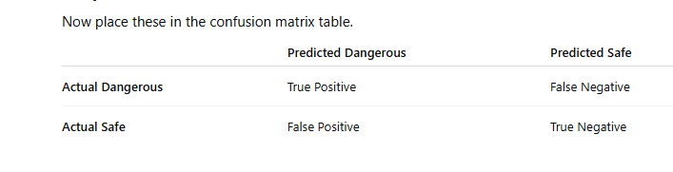

Slide 62
A hospital develops an AI system to detect a viral infection from patient reports. The system predicts either:
Infected or Not Infected
Later, doctors confirm the actual diagnosis after laboratory testing.
During testing of the AI system, the following cases were observed.
Case 1
A patient actually had the infection, and the AI system predicted Infected.
Case 2
A patient was completely healthy, but the AI system predicted Infected.
Case 3
A patient actually had the infection, but the AI system predicted Not Infected.
Case 4
A patient was healthy, and the AI system predicted Not Infected.
Case 5
A patient actually had the infection, and the AI system predicted Infected.
Case 6
A patient was healthy, but the AI system predicted Infected.

Slide 63
Define Positive and Negative
Positive = Patient has infection Negative = Patient does not have infection
Predicted Infected → Positive prediction Predicted Not Infected → Negative prediction

Slide 64
Case 1
Patient infected, AI predicted infected → True Positive (TP) Correct detection.
Case 2
Patient healthy, AI predicted infected → False Positive (FP) False alarm.
Case 3
Patient infected, AI predicted not infected → False Negative (FN) Missed infection.
Case 4
Patient healthy, AI predicted not infected → True Negative (TN) Correct rejection.
Case 5
Patient infected, AI predicted infected → True Positive (TP) Correct detection.
Case 6
Patient healthy, AI predicted infected → False Positive (FP) False alarm.
Final Counts
TP = 2 FP = 2 TN = 1 FN = 1

Slide 65
Confusion Matrix
 | Predicted Infected | Predicted Not Infected
Actual Infected | TP = 2 | FN = 1
Actual Healthy | FP = 2 | TN = 1

Slide 66
Model Evaluation Metrics
Accuracy, Precision, Recall, Specificity
Before starting the metrics, remind students that all these metrics are derived from the confusion matrix.
The confusion matrix gives us four numbers:
True Positive (TP) True Negative (TN) False Positive (FP) False Negative (FN)
Using these four numbers we calculate different evaluation metrics.
Each metric answers a different question about the model's behavior.

Slide 67
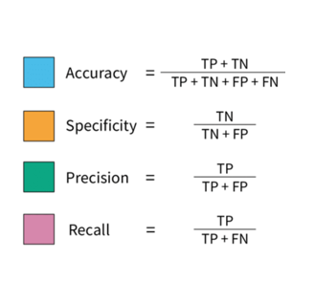

Slide 68
Precision
Precision = TP / (TP + FP)
Measures reliability of positive predictions

Slide 69
Recall
Recall = TP / (TP + FN)
Measures ability to detect actual positives

Slide 70
A hospital is testing an AI model that predicts whether a patient has a certain infection.
The AI gives only two outputs:Disease Present orDisease Not Present
The hospital tested this AI on 200 patients.
After laboratory confirmation, the following results were found:
Out of the 200 patients:
50 patients actually had the disease
150 patients were actually healthy
The AI made these predictions:
It correctly identified 40 diseased patients
It missed 10 diseased patients
It wrongly marked 30 healthy patients as diseased
It correctly identified 120 healthy patients as healthy

Slide 71
Step 1: Identify TP, TN, FP, FN
True Positive (TP)
Patients actually had disease, and AI predicted disease.
So,TP = 40
False Negative (FN)
Patients actually had disease, but AI predicted healthy.
So,FN = 10
False Positive (FP)
Patients were actually healthy, but AI predicted disease.
So,FP = 30
True Negative (TN)
Patients were actually healthy, and AI predicted healthy.
So,TN = 120

Slide 72
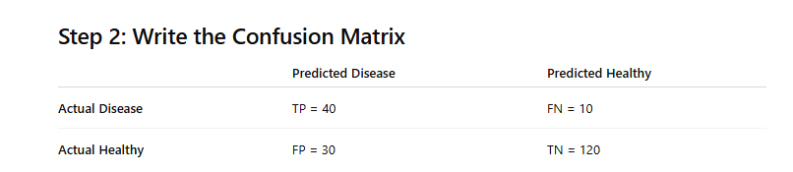

Slide 73
Calculate Accuracy
Formula
Accuracy = (TP + TN) / (TP + TN + FP + FN)
Accuracy = (40 + 120) / (40 + 120 + 30 + 10)
Accuracy = 160 / 200
Accuracy = 0.80
Final Answer
Accuracy = 80%

Slide 74
Step 4: Calculate Precision
Formula
Precision = TP / (TP + FP)
Substitute values:
Precision = 40 / (40 + 30)
Precision = 40 / 70
Precision = 0.5714
Final Answer
Precision = 57.14%

Slide 75
Step 5: Calculate Recall
Formula
Recall = TP / (TP + FN)
Substitute values:
Recall = 40 / (40 + 10)
Recall = 40 / 50
Recall = 0.80
Final Answer
Recall = 80%

Slide 76
Step 6: Calculate Specificity
Formula
Specificity = TN / (TN + FP)
Substitute values:
Specificity = 120 / (120 + 30)
Specificity = 120 / 150
Specificity = 0.80
Final Answer
Specificity = 80%

Slide 77
A hospital is evaluating an AI system that detects a rare infectious disease. The AI predicts either Disease Detected (Positive) or No Disease (Negative).
During evaluation on 500 patients, doctors later confirmed the actual diagnoses.
The following observations were recorded:
Among 120 patients who actually had the disease, the AI correctly identified 95 patients as infected.
The AI mistakenly classified 25 diseased patients as healthy.
Among 380 healthy patients, the AI incorrectly predicted 60 patients as infected.
The remaining healthy patients were correctly predicted as healthy.

Slide 78
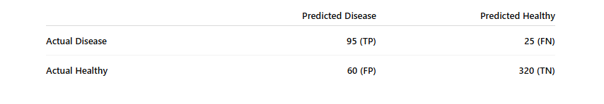
1. Final Values
TP = 95 FN = 25 FP = 60 TN = 320
Final Answers Together
Accuracy = 83% Precision = 61.29% Recall = 79.17% Specificity = 84.21%

Slide 80
Numerical Example
TP = 40, FP = 10, FN = 20, TN = 30
Precision = 80%
Recall = 66%

Slide 81
Summary
Feature Engineering → Improve Input
Cross-Validation → Reliable Evaluation
Precision → Quality of positive predictions
Recall → Coverage of actual positives

